Slide 1
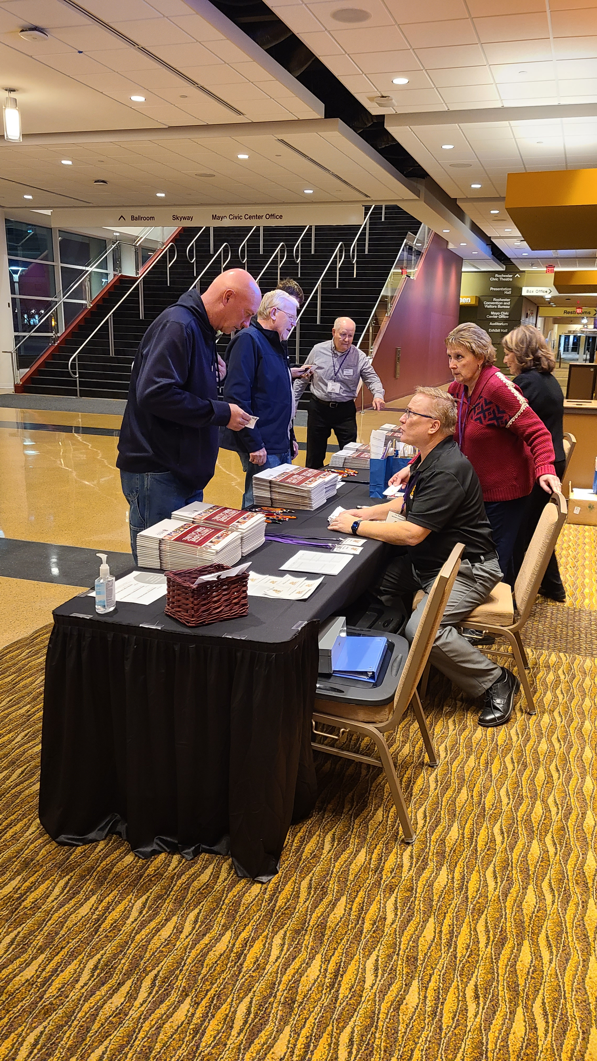
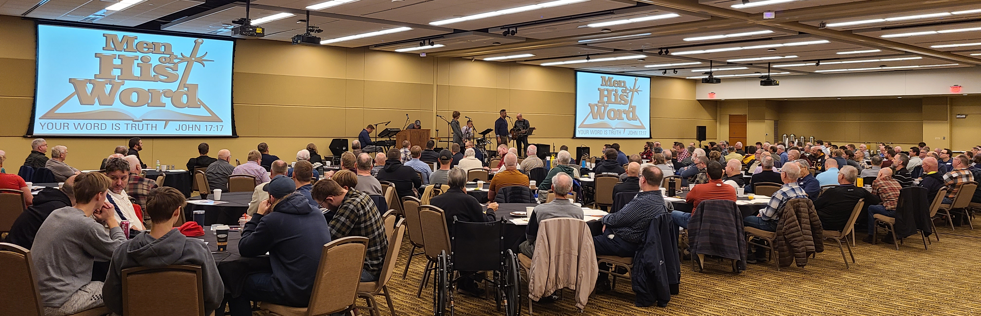
October 28, 2023 – Rochester, MN

Slide 2
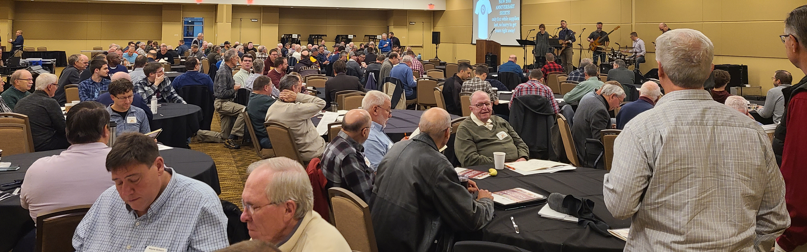

Slide 3
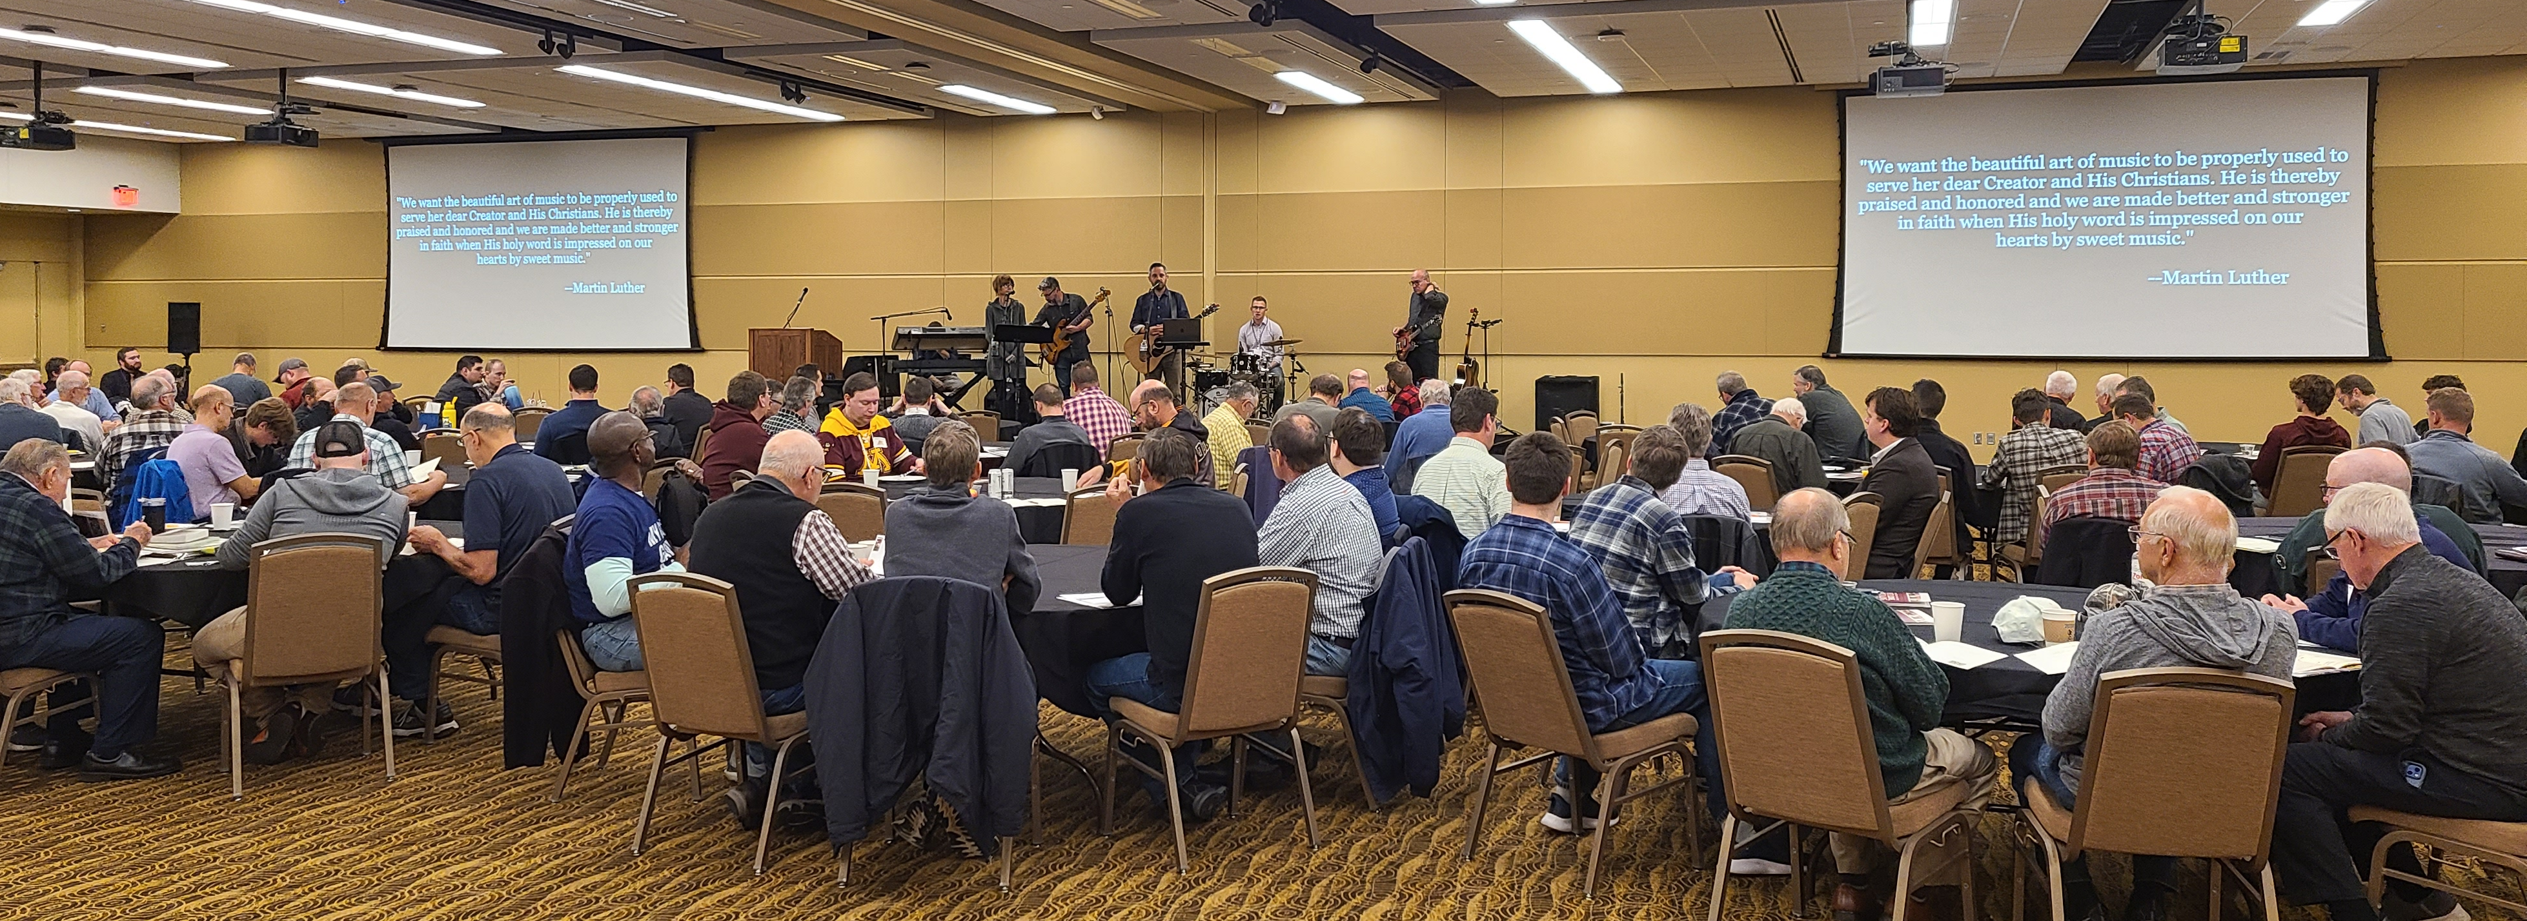
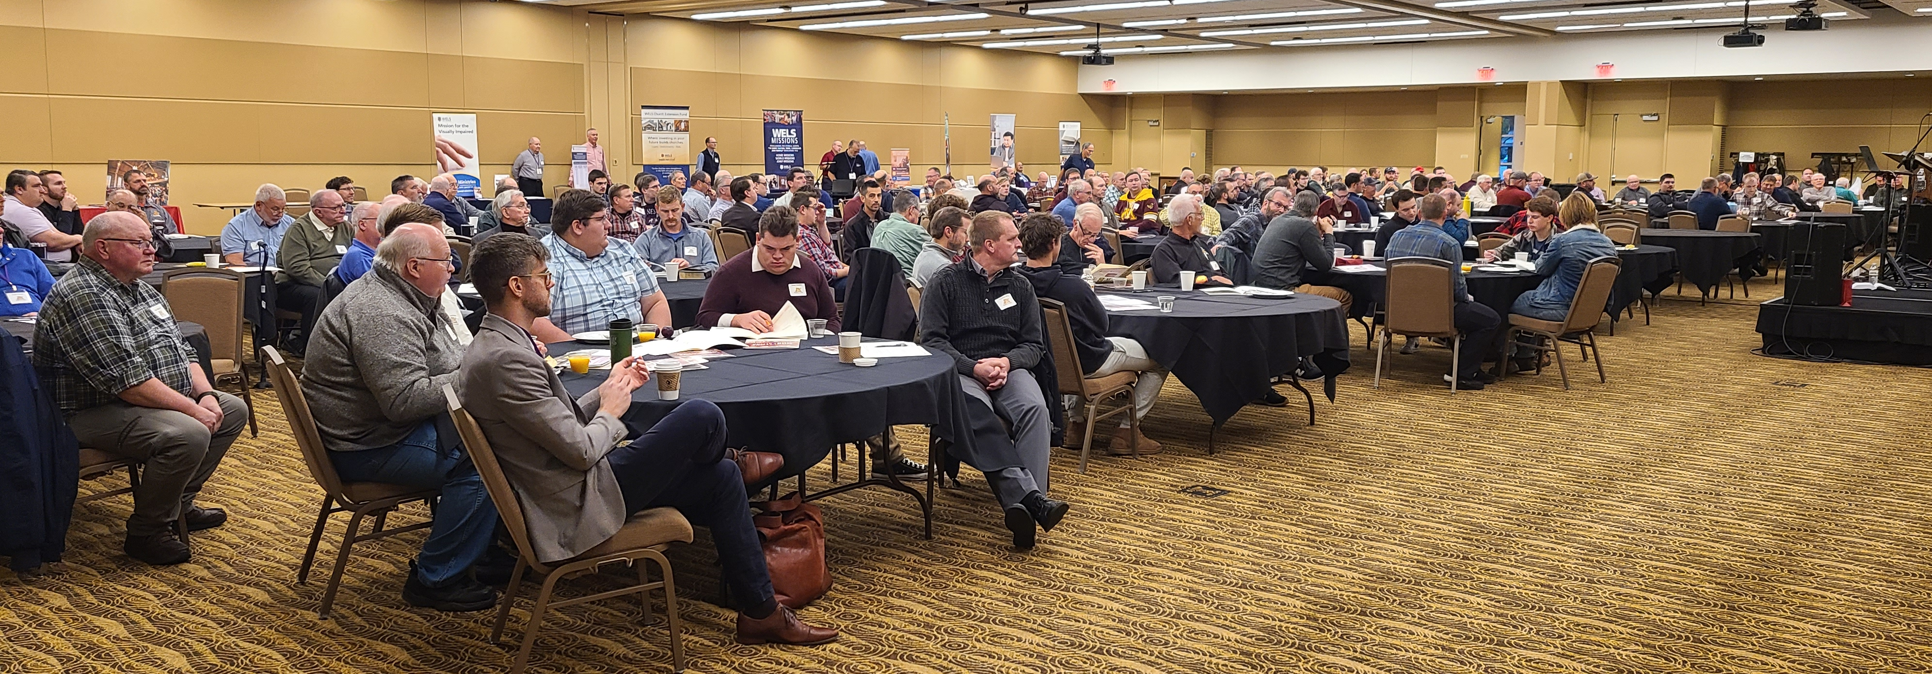
Attendees: 209
Attendee Locations:
Rochester: 45
Surrounding Rochester Area: 46
Twin Cities Area: 36
Western Wisconsin: 35
East & North Wisconsin: 25
Western Minnesota: 16
Other: 7
Attendee Age Ranges:
Under 19: 12
19-25: 17
26-39: 30
40-61: 80
62+: 68

Slide 4
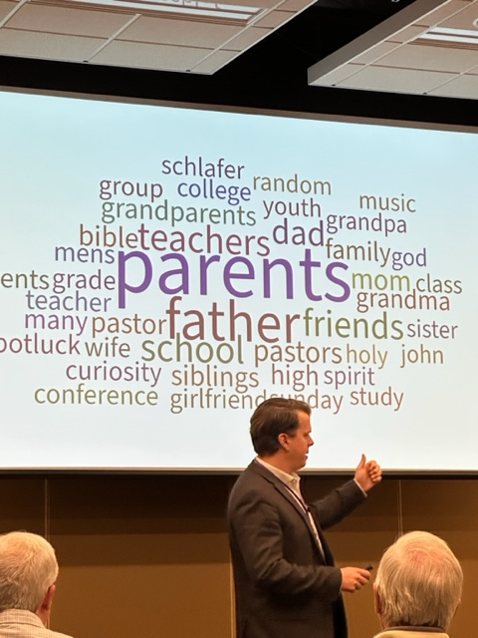
Keynote Presentation
"Relatable, relaxed, practical. I like how things were explained without jargon"
"Effective speaker. Passionate about resilience through Christ.”
Breakout Sessions:
"Good conversation and different approach of thinking about in-reach and out-reach."
"Very good information and tools To be successful in my spiritual journey”
"Awesome. Interactive and relatable"
"Helps personally and how to help others"
"Very useful nuggets of information”
"It was good to know I'm not alone in my struggles”
"Exactly what I needed right now”

Slide 5
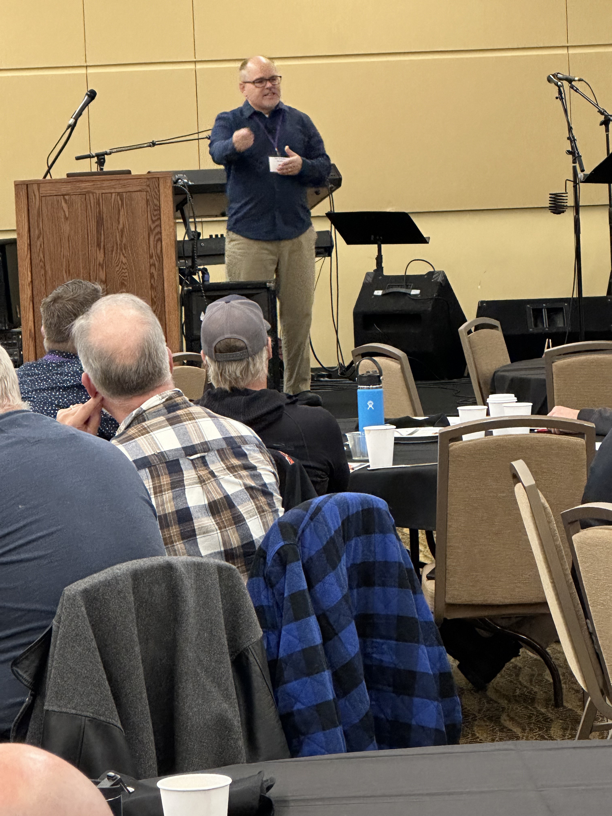
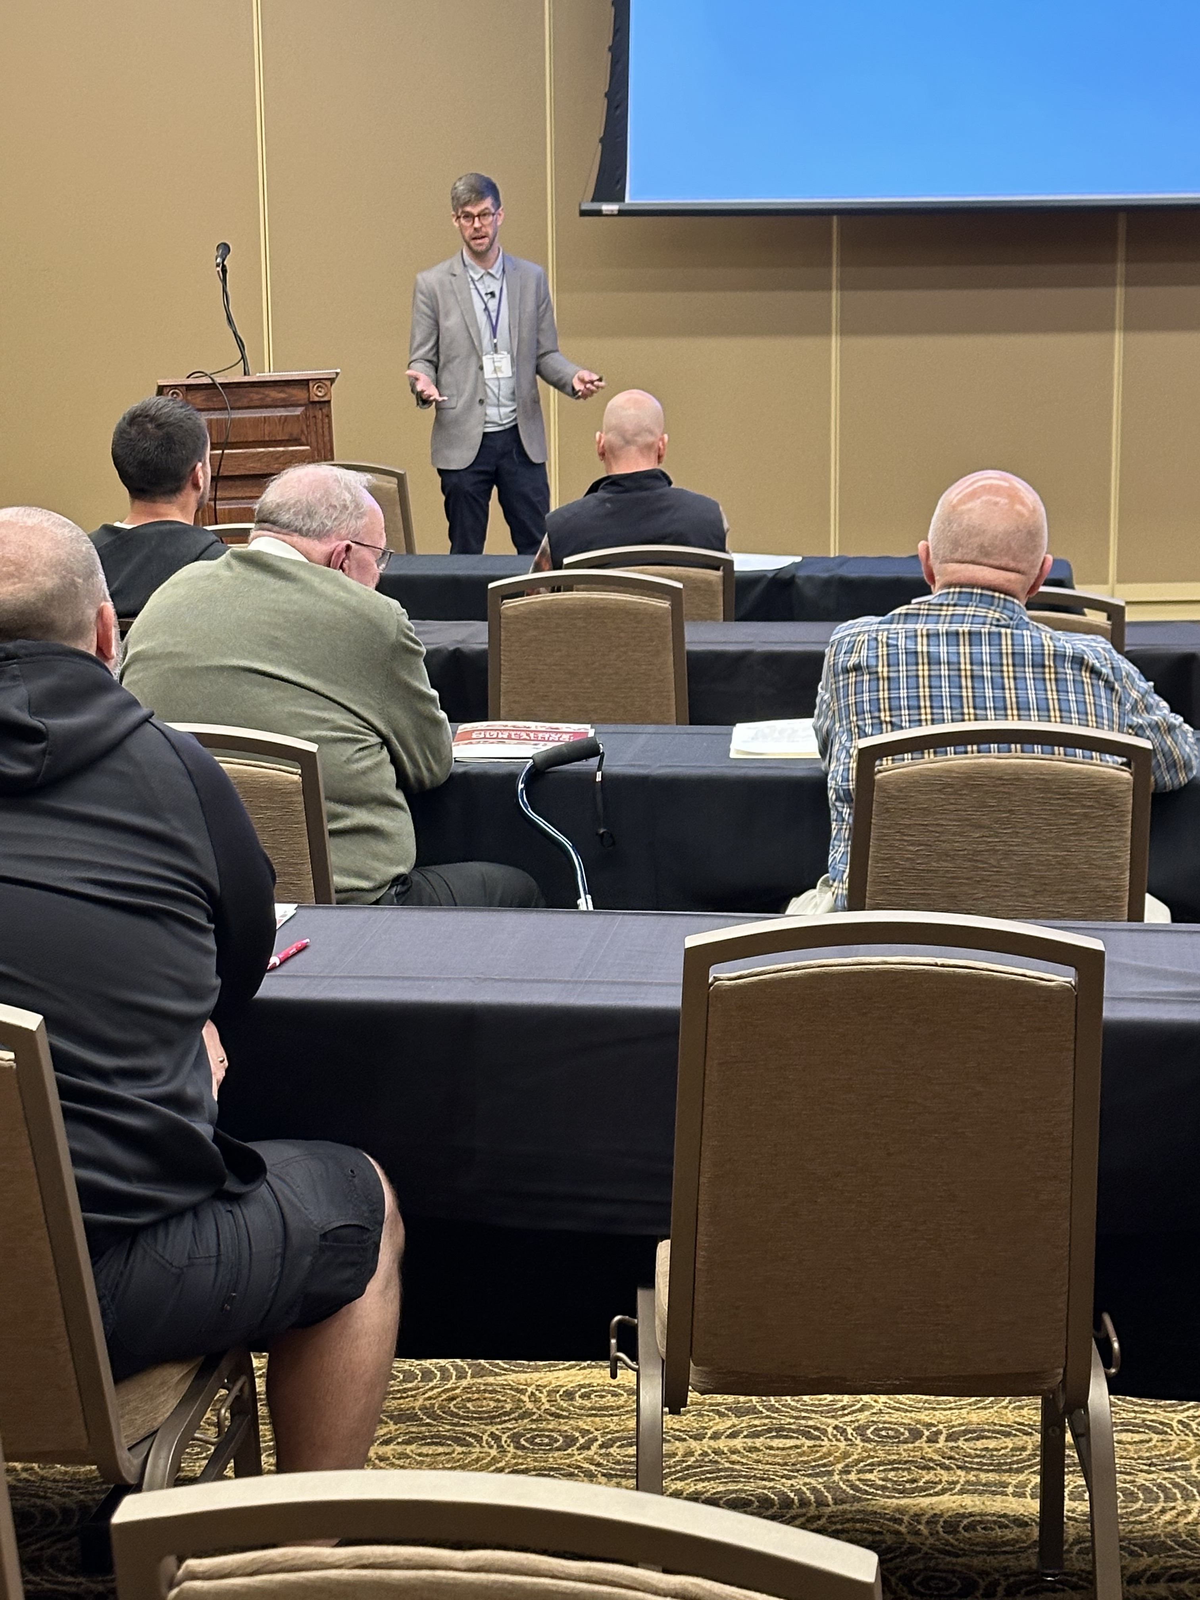
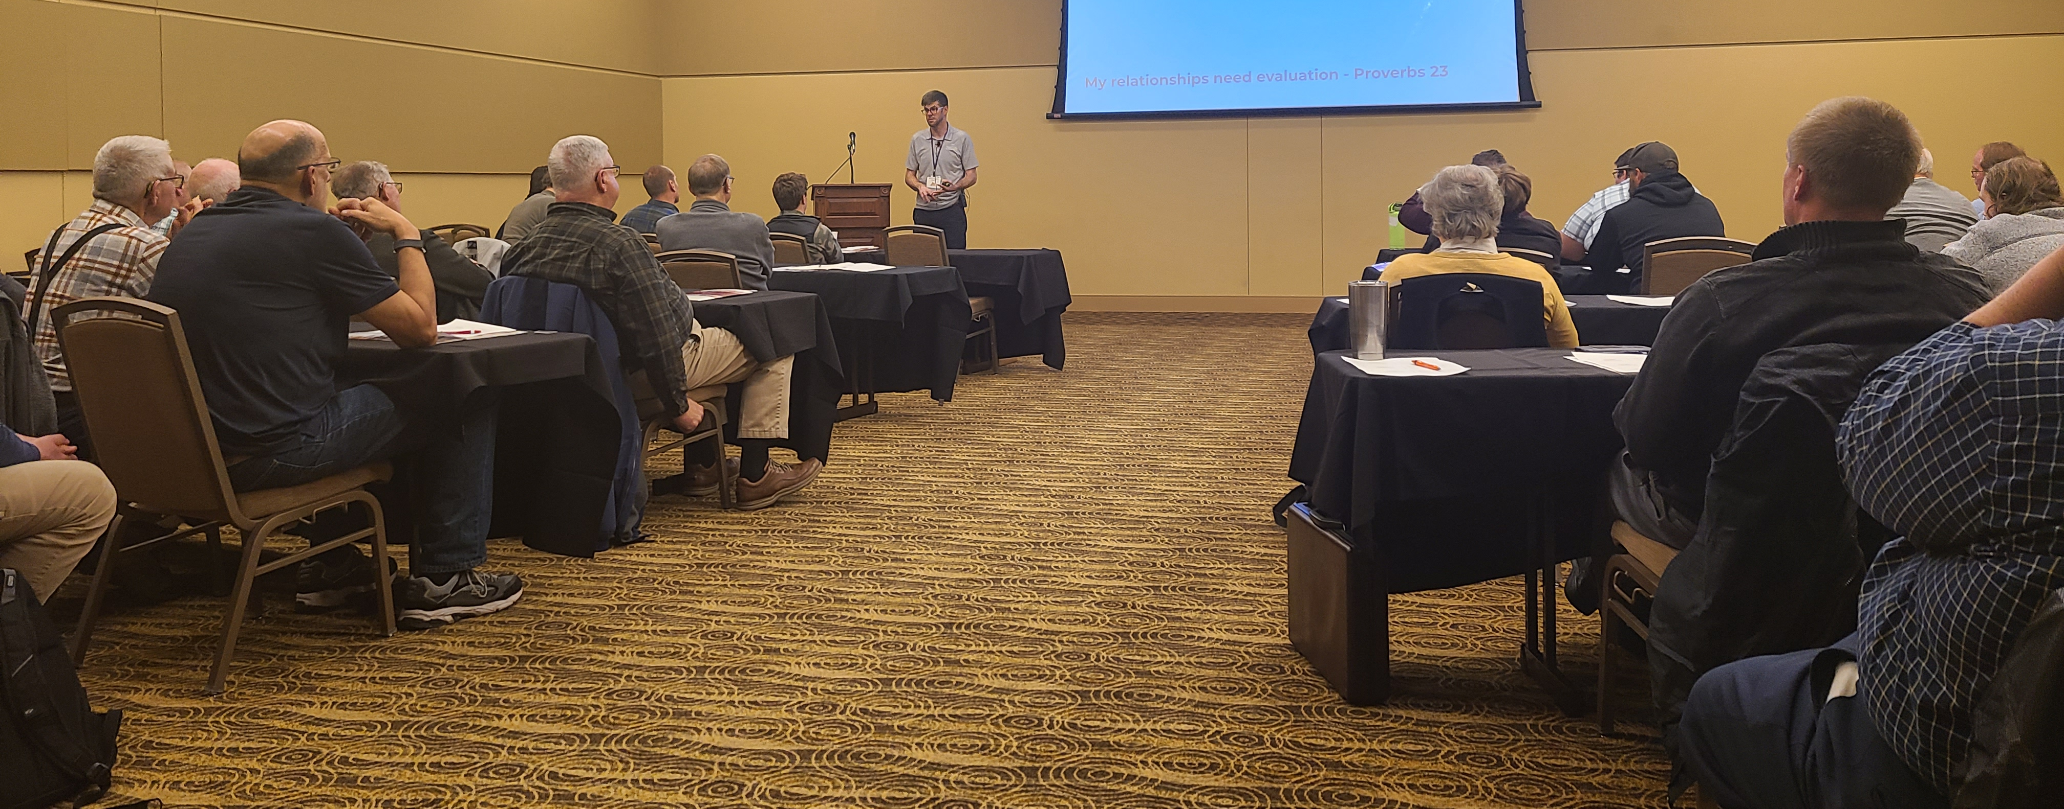
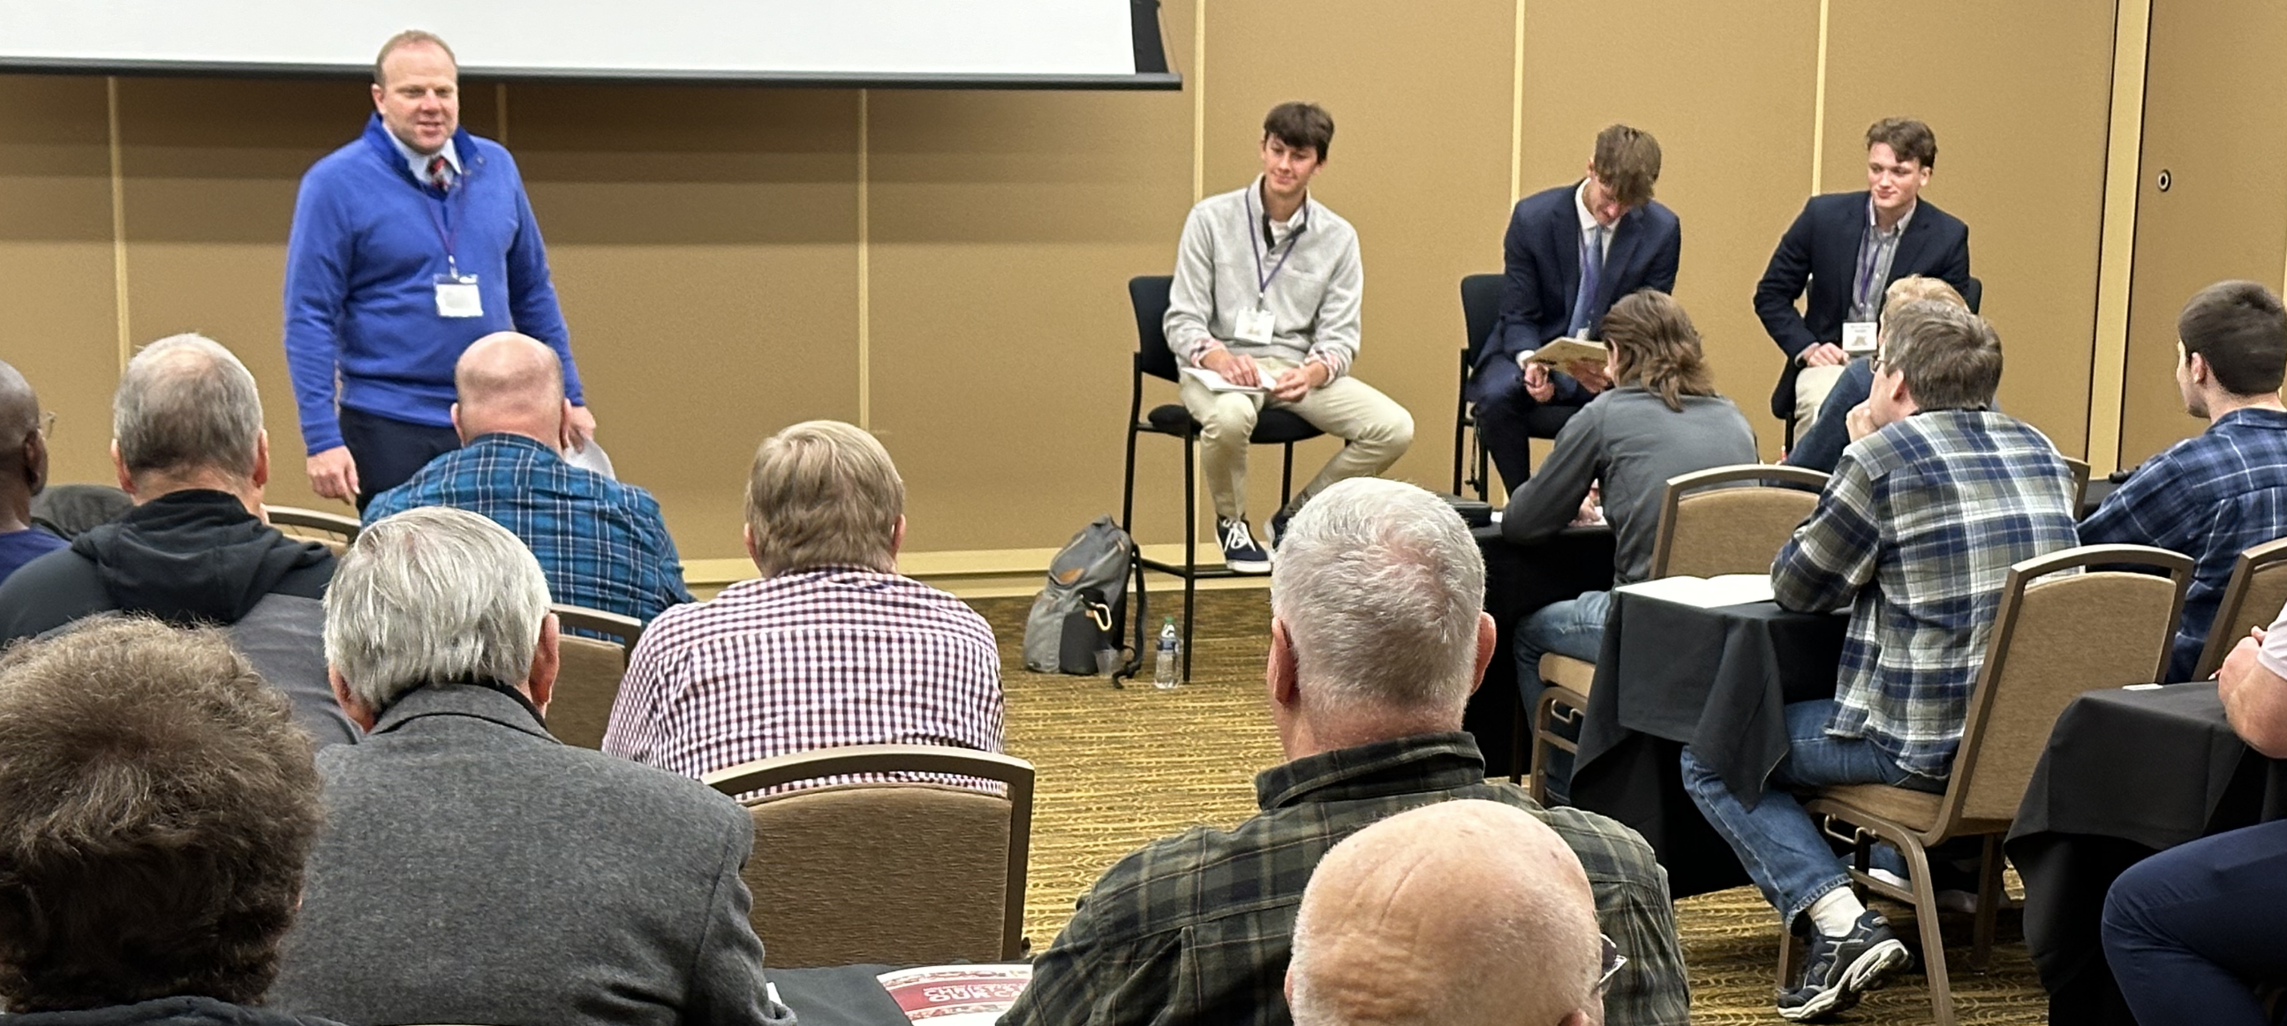
Overall Conference:
"Deepens relationship with Christ and brothers”
"Always a blessing to be able to come and learn with fellow believers”
"Uplifting, rejuvenating”
"I will return and hope to encourage more men of our church to come.”
"I loved this conference and I will come again”
Future Topic Requests:
Marriage
Current world view topics: CRT, LGBTQ+, World Conflicts
Lay Leadership & Church Leadership
World and Home Missions
Anxiety, depression and other mental health issues
Mentoring men and being a mentor
More Parenting topics

Slide 6
October 26, 2024 – Rochester, MN

