Slide 1
Every member evangelism
Shaping your congregational culture to encourage every member to evangelize

Slide 2
Notes:
How is WELS doing when it comes to evangelism?

Slide 3
Some startling stats
Notes:
% of congregations with 0 adult confirmations in 2019
% of congregations with 1 or fewer
% of congregations with 2 or fewer

Slide 4
Some startling stats 2022
Percent of WELS congregations with 0 adult confirmations
46% (551)
Percent of WELS congregations with 1 or fewer adult confirmations
54% (667)
Percent of WELS congregations with 3 or fewer adult confirmations
69% (858)
Notes:
% of congregations with 0 adult confirmations in 2019
% of congregations with 1 or fewer
% of congregations with 2 or fewer

Slide 5
Some startling stats 2022
Percent of WELS congregations with 10 or more adult confirmations
8% (95)
Notes:
% of congregations with 0 adult confirmations in 2019
% of congregations with 1 or fewer
% of congregations with 2 or fewer

Slide 6
Some startling stats 2022
Number of adult confirmands in each of the top 10 WELS congregations
84
46
33
33
32
30
30
28
28
27
Notes:
3 of these have fewer than 400 souls
3 of these have more than 1500 souls
8 are in the Midwest

Slide 7
Why?
Why are some congregations so evangelistically blessed while so many others are not?
Notes:
Why are some congregations so evangelistically blessed while so many are not?
Pair/Share. Group Share.
Note: Some are large. Some are small. Some contemporary. Some traditional.

Slide 8
Things to keep in mind

Slide 9
I planted the seed, Apollos watered it, but God has been making it grow.
- I Corinthians 1:6

Slide 10
And the Lord added to their number daily those who were being saved.
- Acts 3:47

Slide 11
Notes:
We want to be careful not to compare apples to oranges

Slide 12
Notes:
Congregations in different geographical settings

Slide 13
Notes:
Every situation is different – LES? Pastor/people ratio.

Slide 14
Notes:
Congregations with different gifts

Slide 15
As iron sharpens iron,
so one person sharpens another.
- Proverbs 27:17
Notes:
And, frankly, if it wasn’t true that we might be able to learn from others, you’d be wasting your time at the NCLL and this breakout

Slide 16
Notes:
Researched 4500 Christian congregations
Interviewed 57 pastors at top-10-percent conversion-growth churches

Slide 17
Missional
Leaders
Missional
Congregation
Conversion
Community

Slide 18
Model personal outreach.
Model integrating an evangelistic concern into the ministries they lead
Missional
Leaders

Slide 19
Missional
Leaders
Missional
Congregation
Conversion
Community

Slide 20
An entire culture that engages with people outside the church, brings them in and extends spectacular hospitality when they visit
This engaged, invitational, hospitable culture characterizes the congregation as a whole.
Missional
Congregation

Slide 21
Missional
Leaders
Missional
Congregation
Conversion
Community

Slide 22
The congregation is growing (at least 5% per year)
Unchurched people are coming to the church and staying
Outreach and witness are integrated into every ministry and priority the church has
Conversion
Community

Slide 23
Missional
Leaders
Missional
Congregation
Conversion
Community
Outreach Culture
Notes:
They discovered it is NOT programs or even strategy. It is having a CULTURE of outreach.

Slide 24
What can we do to help this happen?
Notes:
But how do we help this happen?

Slide 25
Top ten predictive factors of “conversion growth”
Identify at least two
Notes:
Surveyed 1500 senior pastors and discovered ten predictive factors of conversion growth
Did regression analysis to weed out non-typical factors
Pair/share. Group share.

Slide 26
Top 10 predictive factors of “conversion growth”
Church invites, includes and involves the unchurched
Pastor regularly teaches a next-steps class
Pastor regularly attends evangelism training
Pastor regularly personally evangelizes
Church puts its money where its mouth is, into outreach
Members (not just pastor) are reaching out
Pastor translates sermon to unchurched people and their lives
Church ministry engages community
Church culture attracts transfers as well as unchurched people
Pastor blocks out time in calendar to personally reach out
Notes:
Reveal and then allow folks to take a picture
I am going to suggest that one of these is most critical for significant evangelism impact…

Slide 27
Top 10 predictive factors of “conversion growth”
Church invites, includes and involves the unchurched
Pastor regularly teaches a next-steps class
Pastor regularly attends evangelism training
Pastor regularly personally evangelizes
Church puts its money where its mouth is, into outreach
Members (not just pastor) are reaching out
Pastor translates sermon to unchurched people and their lives
Church ministry engages community
Church culture attracts transfers as well as unchurched people
Pastor blocks out time in calendar to personally reach out
Notes:
Anecdotal examples of NAD
All the rest SUPPORT this

Slide 28
Every Member Evangelism
Pastor
Church
Notes:
There are things the church can do and things the pastor can do to support every member evangelism.

Slide 29
Missional
Leaders
Missional
Congregation
Conversion
Community
Outreach Culture
Notes:
To the degree that you have evangelistic leaders and an evangelistic congregation you will see evangelism results.

Slide 30
Notes:
Ways the pastor supports ever member evangelism

Slide 31
Top 10 predictive factors of “conversion growth”
How many of the 10 predictive factors have to do with the pastor?

Slide 32
Top 10 predictive factors of “conversion growth”
Church invites, includes and involves the unchurched
Pastor regularly teaches a next-steps class
Pastor regularly attends evangelism training
Pastor regularly personally evangelizes
Church puts its money where its mouth is, into outreach
Members (not just pastor) are reaching out
Pastor translates sermon to unchurched people and their lives
Church ministry engages community
Church culture attracts transfers as well as unchurched people
Pastor blocks out time in calendar to personally reach out
Notes:
Anecdotal examples of NAD
All the rest SUPPORT this

Slide 33
Top 10 predictive factors of “conversion growth”
Church invites, includes and involves the unchurched
Pastor regularly teaches a next-steps class
Pastor regularly attends evangelism training
Pastor regularly personally evangelizes
Church puts its money where its mouth is, into outreach
Members (not just pastor) are reaching out
Pastor translates sermon to unchurched people and their lives
Church ministry engages community
Church culture attracts transfers as well as unchurched people
Pastor blocks out time in calendar to personally reach out

Slide 34
Number four: pastor regularly personally evangelizes
Why is this important to every-member evangelism?
Discuss how active your pastor is in personal evangelism.
Discuss ways to help him become more active.
Notes:
Pair/share. Group share.

Slide 35
Top 10 predictive factors of “conversion growth”
Church invites, includes and involves the unchurched
Pastor regularly teaches a next-steps class
Pastor regularly attends evangelism training
Pastor regularly personally evangelizes
Church puts its money where its mouth is, into outreach
Members (not just pastor) are reaching out
Pastor translates sermon to unchurched people and their lives
Church ministry engages community
Church culture attracts transfers as well as unchurched people
Pastor blocks out time in calendar to personally reach out

Slide 36
Number five: pastor translates sermon to unchurched people and their lives
Why is this important to every-member evangelism?
Notes:
Pair/Share. Group Share.
Not necessarily ABOUT unchurched people
ACCECIBLE to unchurched people so they understand what you are saying
APPLICABLE to unchurched people and their lives

Slide 37
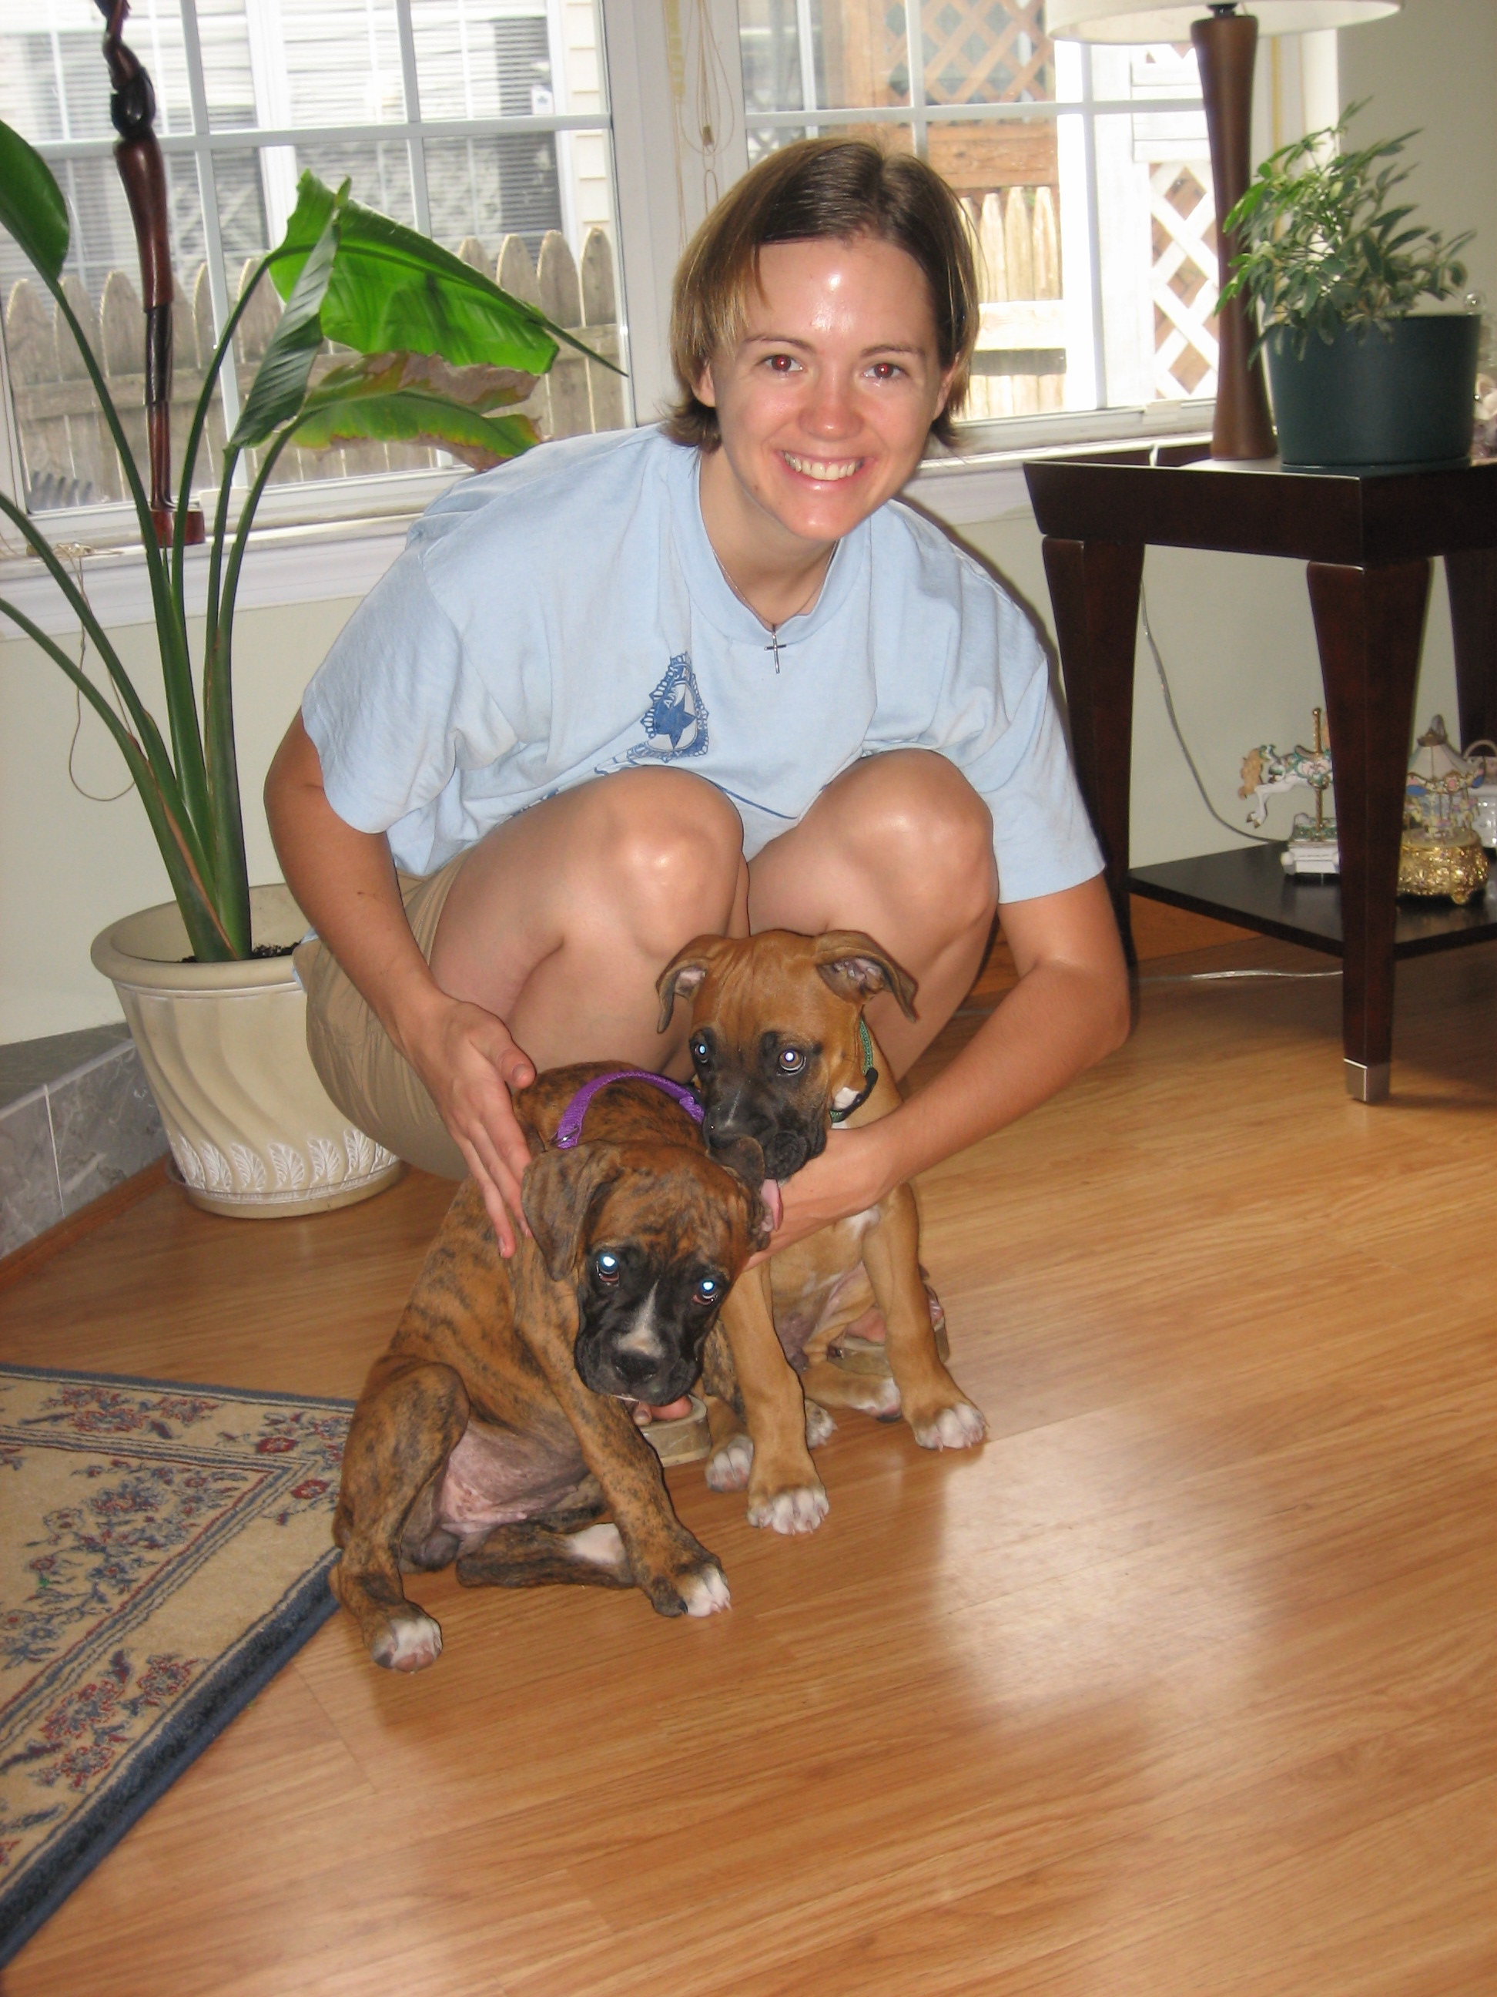

Slide 38
Missional
Leaders
Missional
Congregation
Conversion
Community
Outreach Culture
Notes:
To the degree that you have evangelistic leaders and an evangelistic congregation you will see evangelism results.

Slide 39
Top 10 predictive factors of “conversion growth”
Church invites, includes and involves the unchurched
Pastor regularly teaches a next-steps class
Pastor regularly attends evangelism training
Pastor regularly personally evangelizes
Church puts its money where its mouth is, into outreach
Members (not just pastor) are reaching out
Pastor translates sermon to unchurched people and their lives
Church ministry engages community
Church culture attracts transfers as well as unchurched people
Pastor blocks out time in calendar to personally reach out

Slide 40
Top 10 predictive factors of “conversion growth”
Church invites, includes and involves the unchurched
Pastor regularly teaches a next-steps class
Pastor regularly attends evangelism training
Pastor regularly personally evangelizes
Church puts its money where its mouth is, into outreach
Members (not just pastor) are reaching out
Pastor translates sermon to unchurched people and their lives
Church ministry engages community
Church culture attracts transfers as well as unchurched people
Pastor blocks out time in calendar to personally reach out

Slide 41
Number One: Church invites, includes and involves the unchurched
What do you think this means?
How does this support every member witnessing?
Share at least three ways your congregation could invite, include and involve the unchurched.
Notes:
Pair/Share
Group Share

Slide 42
Top 10 predictive factors of “conversion growth”
Church invites, includes and involves the unchurched
Pastor regularly teaches a next-steps class
Pastor regularly attends evangelism training
Pastor regularly personally evangelizes
Church puts its money where its mouth is, into outreach
Members (not just pastor) are reaching out
Pastor translates sermon to unchurched people and their lives
Church ministry engages community
Church culture attracts transfers as well as unchurched people
Pastor blocks out time in calendar to personally reach out
Notes:
If there is time talk about the ones we haven’t covered
Encourage them to discuss these in their congregations

Slide 43
www.everyoneoutreach.com

Slide 44
www.welscongregationalservices.net

Slide 45
Rev. Eric Roecker
Director – WELS Commission on Evangelism
eric.roecker@wels.net
414-256-3287

