Slide 1
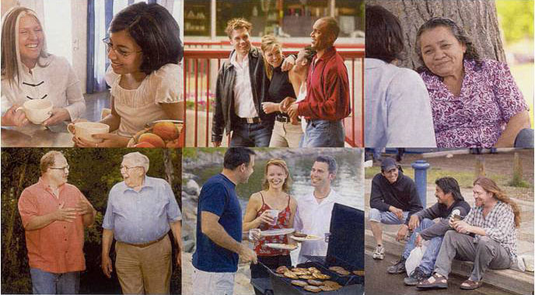
Starting a Spiritual Conversation
Sharing Jesus with friends

Slide 2
Nika
Evangeline
Anastasia
Isaiah
Zoe
Dahlia >
My Family of Eight

Slide 3
My family of… many

Slide 4
Immanuel

Slide 5
Immanuel Ev. Lutheran Church
Greenville, WI

Slide 6
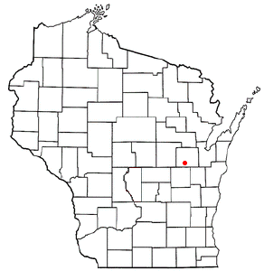
Where is Greenville?

Slide 7
The Pastors of Immanuel

Slide 8
The Pastors of Immanuel

Slide 9
The Pastors of Immanuel

Slide 10
The Pastors of Immanuel

Slide 11
Three Pillars of Ministry

Slide 12
Getting Started
Listening Activity:
Partner up. Pick one person to tell his/her life story in one minute. The other person listens.
Was your partner listening?
How can you tell?

Slide 13
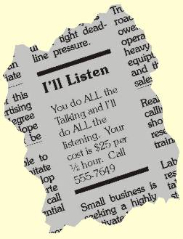
Getting Started
Listen actively
Earn the right to speak by listening first!
Notes:
We don’t view them as projects!

Slide 14
Why did they join the church?
Put the following percentages where you think they belong: 3%, 9%, 14%, 18%, 56%
___ Because of previous loyalties to that denomination
___ Because the pastor visited them
___ Because a friend or relative invited them
___ Because trained lay members visited them
___ Because of the church’s location or building

Slide 15
Chance to Win Fabulous Prizes
Why did they join the church?
_14%_ Because of previous loyalties to that denomination
_3%_ Because the pastor visited them
_56%_ Because a friend or relative invited them
_9%_Because trained lay members visited them
_18%_Because of the church’s location or building

Slide 16
Turn the Conversation
Sharing Jesus with friends

Slide 17
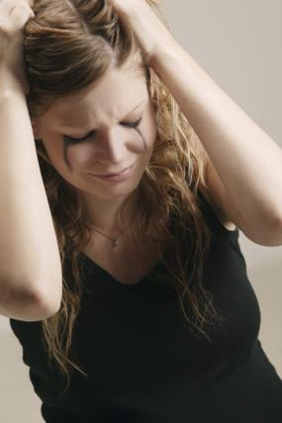
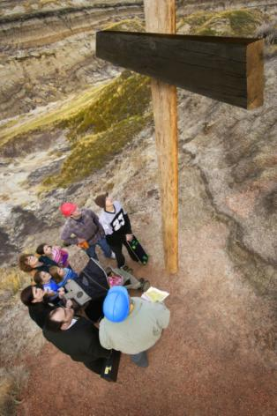
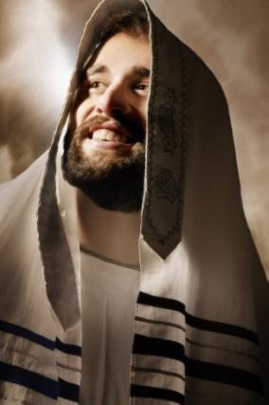
Feel…Felt…Found
Addressing people’s problems:
p roblems
P roblem
S olution
s olutions
SIN

Slide 18
Addressing people’s problems:
(In a group of two, discuss ways of turning the following problems – work through pPSs)
p roblems - Low Self-Esteem; Tired of disappointing family; Alcohol addiction; The feeling of no point to life
P roblem
S olution
s olutions
Notes:
What are problems that friends face…

Slide 19
Talk about Jesus
Sharing Jesus with friends

Slide 20
My Faith according to the Apostles’ Creed
1st
2nd
I believe in the God of Saving Love
3rd
I believe in the God of Eternal Hope
I believe in the God of All-Power

Slide 21
Romans 6:23
in Christ Jesus
our Lord.
eternal life
PEOPLE
GOD
The wages of sin is ...
but the gift of God is ...
DEATH

Slide 22
Road Blocks
With your partner, discuss the reasons people (we) give for not wanting to share our faith. Come up with a list of as many reasons as you can.
(2 minutes)

Slide 23
Really?
Tell me why I shouldn’t be afraid!
Rejection will happen
Luke 10:16
The Holy Spirit helps me with
the right words
Matthew 10:19-20
God’s Word works
Isaiah 55:10
Jesus will be with me
Matthew 28:20

Slide 24
Follow-up with friends
Sharing Jesus with friends

Slide 25
Online

