Slide 1
Welcome! Send us your nuns? Presenters: Blain Parsons, Scott Krause, Bill Neubauer
Sadly, a growing percentage of our society identifies their religious affiliation as "none"- or "nun". Learn how 3 average laymen from Watertown have built a successful ministry to reach this group and how their original plan is far different from what has developed. We'll review some history of our community outreach, current ministerial concept to implementation, and all of the trials and tribulations in between. A breakdown of a weekly 3-hour session will be reviewed. You'll learn how easily you can start a ministry too!

Slide 2
From Watertown, WI Bill Neubauer – St Matthew, Oconomowoc Scott Krause – St Luke, Watertown Blain Parsons – Immanuel, Johnson Creek
We're 3 average laymen of varying backgrounds from Watertown who became good friends over the years. All of us have been involved in various committees, boards (boreds), councils, school functions and the like within their congregations. We all have a strong desire to spread and share God's Word within our community.

Slide 3
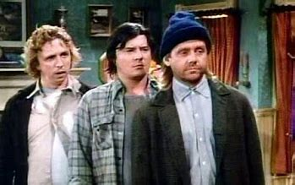
Better known as Larry, Darryl and Darryl:

Slide 4
Watertown History 4 WELS churches in town 20+ years ago an idea Pastor Michael Jensen – Western WI District President
A youth center was formed for ages 7th thru 12th grade
Pastor Tim Mueller called to serve as director – in 15 yrs contact was made to share God's word to over 3,000 youth!
Community resistance to community appreciation
Baptisms, confirmation, church membership!
After age 18, not permitted to participate.

Slide 5
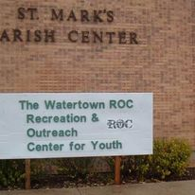
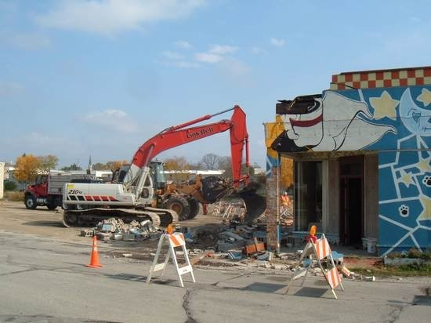
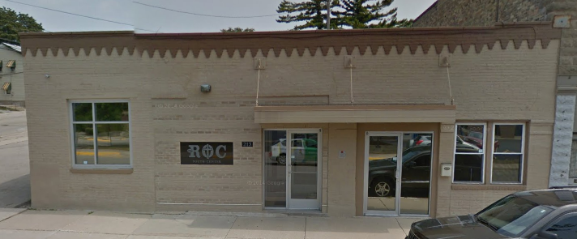
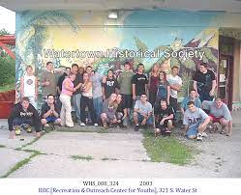
ROC – Recreation and Outreach Center

Slide 6
What does God want us to do with our time on Earth?

Slide 7
What does God want us to do with our time on Earth?
To spread and share His word with others.
2 Timothy 4:2
² Preach the word; be prepared in season and out of season; correct, rebuke and encourage—with great patience and careful instruction.

Slide 8
We/I drifted away from the ROC Ministry, but remained friends, meeting together every few weeks or so (lots of beer, wings, and pizza!) This was always a concern of ours: After age 18, not permitted to participate.
I prayed for guidance – for years.
What I heard – be patient, you'll know when and what to do.
October 18th, 2022 Children's Hospital

Slide 9
Rocketship Ministry is born! October 26, 2022
Why Rocketship? – putting butts in the seats on the rocket to heaven!
Asked ROC board, thankfully given permission
Building vacant Sunday, Monday, Tuesday

Slide 10
Alarm Bells!!!!! Tell your pastor you’re starting a ministry and see what happens. Don’t tell them, ask them!
Don't ask them, tell them!

Slide 11
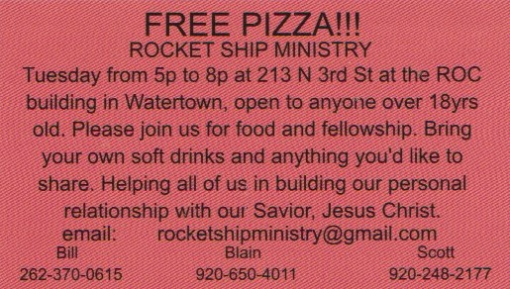
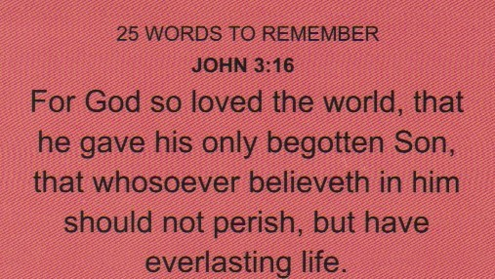
Business Card
https://www.youtube.com/watch?v=ybEhVD5XsAQ Walther John 3:16 sermon cut to 29:35 mark

Slide 12
Our mission plan – provide guidance and life skills to newly graduated ROC youth. Mentoring. WRONG! Several reasons: immature teensagers, know answers, hang out with old guys, too cool, not interested in devotion, horseplay. "Fail to plan – plan to fail" - did we plan too much? Not what God had planned for us.
Time to regroup and reevaluate our Ministry.

Slide 13
Regroup: How did we do it and what did we do? Facebook posting from ROC Facebook from former Pastor Director Email contact database – past involvement Encouraging attendees to invite friends Not contacting churches?

Slide 14
Open from 5-8p every Tuesday We have people waiting at the door at 4:30 in summer 5-6 Dinner 6-7 devotion – best part 7-8 close - fellowship

Slide 15
Dinner: Rarely have pizza, generous support of others, items from food pantry in town, open with prayer and common table prayer, eat, cleanup, catching up with each other, addressing concerns. picking dishwashers We’ve grown to be like family with each other!
Thanksgiving Meal
45 attended – special invites – full meal
(many don’t have a family Thanksgiving meal at home)

Slide 16
Devotion: rotate among 4 facilitators, seminarians, retired pastor Sources: Time of Grace, sermons from local 4 churches, Meditations, The Action Bible, videos, Lutheran Digest, ACTS, Forward in Christ, PGM radio, customized devotions, endless resources! Use mostly WELS material.
Don’t call on people to read – more attentive to video rather than reading – take volunteers
End with around the room prayer – everyone is called upon by name and encouraged.

Slide 17
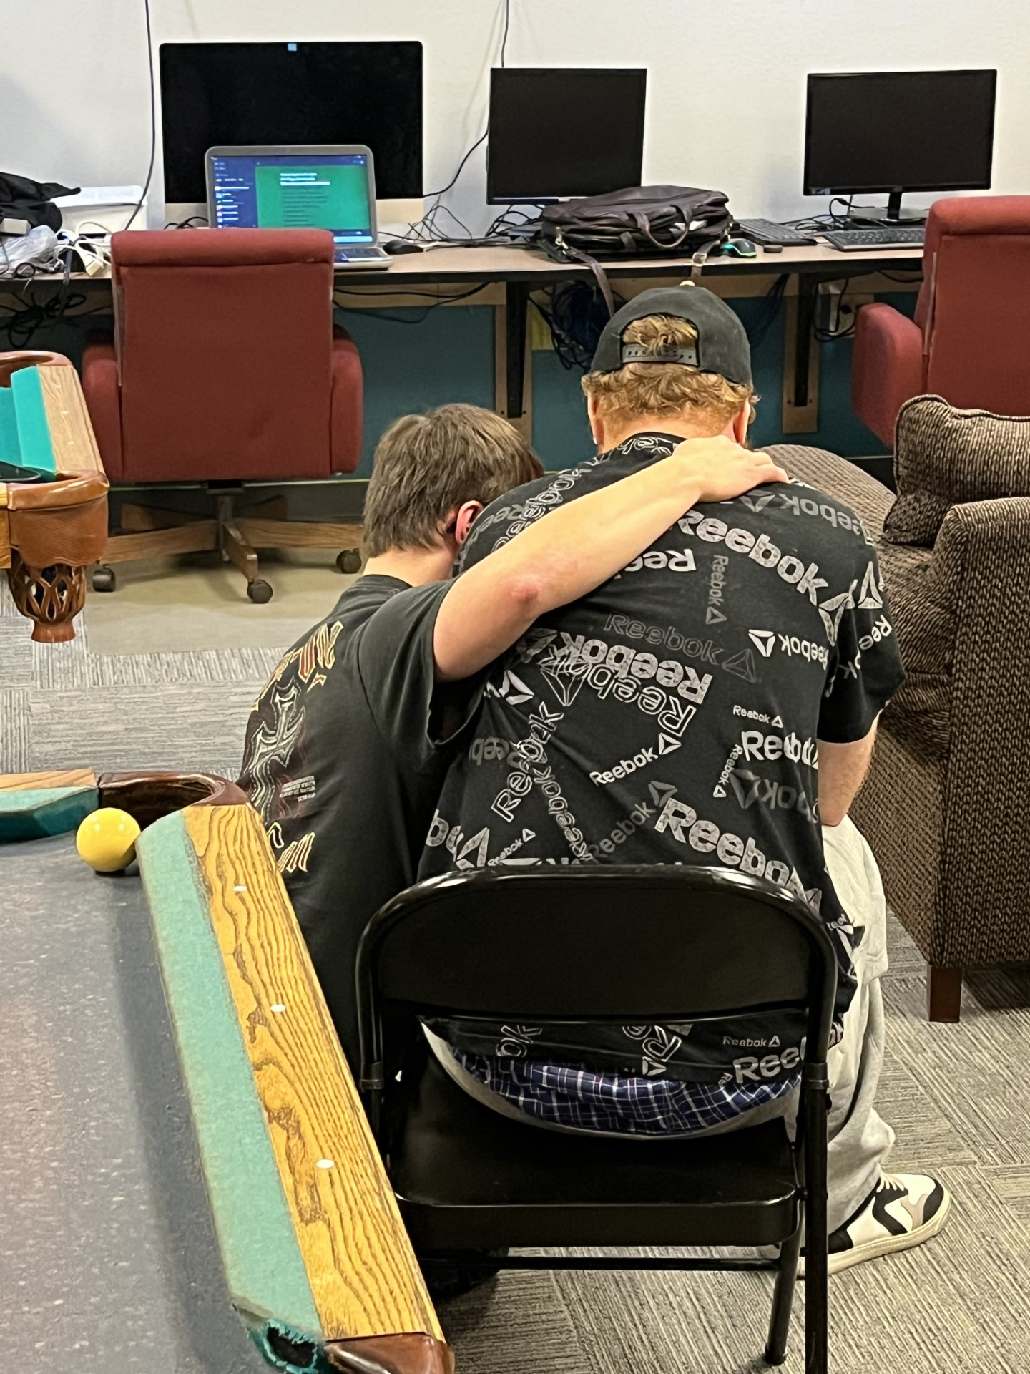
Fellowship: 7-8p Great way to finish evening! Card games, lots of chatting, pool table, bingo and such with prizes, building friendship Gifts with Bible verse Music!!!
This is what it’s all about! ➔

Slide 18
Observations:
Is St Marks a Lutheran or Christian church?
20/20/60 group – church bubble? Funding: don’t need it! $30 per week? Donations and support, unexpected surprise! Meet and greet every new attendee – get cell and contact info, birthday for monthly party – develop sense of belonging Hand out cards and personally invite Patience and understanding Loyalty, staying full 3 hours Attentive during devotions How to advertise? Word of mouth, personal invites. Not judgemental, treat everyone with respect – all souls matter! 75 souls – largely male, try to develop more female attendance. 18+ age group
Our age group goes from early 20’s to 70’s
Many think it’s just for youth
Follow up if you haven’t seen in a while – anything we can pray for?
Address issues immediately - share information/issues

Slide 19
Fun! We get to share God’s word. We’re sharing the word with a group that may not be targeted by churches.
End of night is refreshing and enlightening
Learn too, look up answers
No boss – all 3 make decisions together unconstrained ministry
Every night is different

Slide 20
Lessons learned: Thank you’s ROC Board wanted to assimilate our ministry as part of their ministry. Resistance to request Very demanding – but rewarding! Never know what God will have walk through the door

Slide 21
What we are not:
Babysitting service - dealing with young who just want to play – maturity
We are not authorized/approved by any congregation or pastor.
Recruiters for the local congregations
Judgy, not a food pantry/community dinner/ rec center
Last time to church? – last Tuesday –
First and foremost – we are a Ministry!!!

Slide 22
Advice:
Have at least 2-3 start - caution on how often Wear clothing that is similar to attendees Design it the way you would like – have fun Ownership, assigning and participation Track names and contact info Address disruptive behavior right away Brothers – no formal training, ordinary average guys! Big time commitment – but so rewarding in many ways Mutual servitude – not one way – can be taken advantage of easily

Slide 23
Questions?

